Slide 1
CS 200
Additional Topics and Review
Jim Williams, PhD

Slide 2
Week 15
Final Exam: Conflict Alternatives Emailed
Monday, December 17th, 2:45 – 4:45 pm, Location?
P7 due Wednesday
Team Lab: Optional
Last lecture and office hours Wednesday
Thursday, TA Review @1461, @1786
Lecture: Additional Topics, Review
Course Evaluation: Thank You!

Slide 3
The 2nd toString method is ________
Overriding
Overloading
public class Cup {
private String owner;
public String toString() {
return this.owner;
}
public String toString(String type) {
return type;
}
}
Notes:
overloading, since same name different parameters

Slide 4
Commonly Missed

Slide 5
What is the value of m(3)?
public static int m(int n) {
System.out.println( n);
return n;
}
Notes:
The value of the method is what is returned, not what is printed out.

Slide 6
What is output?
1 3 j=4
3 3 j=6
other
public static int m(int n) {
System.out.println( n);
return n;
}
public static void main(String[] args) {
int i = 1;
int j = m(i) + (i = m(3));
System.out.println("j=" + j);
}
https://cs200-www.cs.wisc.edu/wp/precedence-associativity-and-order-of-evaluation/
Notes:
try it.

Slide 7
What is print out?
public static String first3(String in) {
return in.substring(0,3);
}
public static void main(String []args) {
String s = "2018";
first3( s);
System.out.println( s);
}
Notes:
try it.

Slide 8
What is print out?
String str = "1\t2\n3";
Scanner scan = new Scanner( str);
scan.nextInt();
scan.next();
System.out.println( "#" + scan.nextLine() +"#");
Notes:
try it.

Slide 9
What is print out?
ArrayList<String> str = new ArrayList<String>();
ArrayList<String> str2 = str;
str = null;
str2.add("Bucky");
str = str2;
str2.add("Badger");
System.out.println(str);
Notes:
try it.

Slide 10
Memory
public class M {
int varName = 1;
static int cVar = 2;
public M(int varName ) {
this.varName = varName;
}
public static void main(String []args) {
M[] varName = new M[3];
varName[0] = new M(3);
varName[1] = new M(4);
}
}
Notes:
instance variable: varName
class variable: cVar
parameter: args, varName (in M)
local variable: varName (in main)
the array is allocated on the heap, reference to array saved in local variable varName

Slide 11
How many Bug instances in list?
2
2 copies of reference to 1 bug
none, error, no list
3
ArrayList<Bug> list;
list = new ArrayList<Bug>();
list.add( new Bug());
Bug aBug = new Bug();
list.add( aBug);
list.add( 0, aBug);
Notes:
// 2 instances of Bug
import java.util.ArrayList;
class Bug {
private static int count = 0;
private final int id;
Bug() {
id = ++count;
}
public String toString() {
return "Bug:" + id;
}
}
public class ClassNameHere {
public static void main(String[] args) {
ArrayList<Bug> list = new ArrayList<>();
list.add( new Bug());
Bug aBug = new Bug();
list.add( aBug);
list.add( 0, aBug);
System.out.println( list);
}
}

Slide 12
What is stored on the stack?

Slide 13
How many arrays?
int [][] table = new int[3][];
table[2] = new int[]{1,2,3};
table[0] = table[2];
table[1] = new int[]{4,5};
table[0][0] = table[1][1];
System.out.print(table[2][0]);
Notes:
3: one array in initial table, 2 new row arrays allocated.

Slide 14
Course Review
Key Principles, Tools, Diagrams, Data Types, Operators, Keywords, Control Flow, Programming Paradigms, Debugging Techniques, File Input/Output, Commenting & Style, Unit Testing, Memory, Best Practices, Learning Programming

Slide 15
Tools
zyBooks, JavaVisualizer, DiffChecker, Command Prompt, notepad, javac, java, Eclipse IDE (editor, compiler, vm, debugger)

Slide 16
Diagrams
truth tables, memory model diagrams, control flow charts (activity diagrams), class diagrams, object diagrams, and use-case diagrams.

Slide 17
Data Types
Primitive & Reference
Primitive: 8
Reference: existing, classes you write.

Slide 18
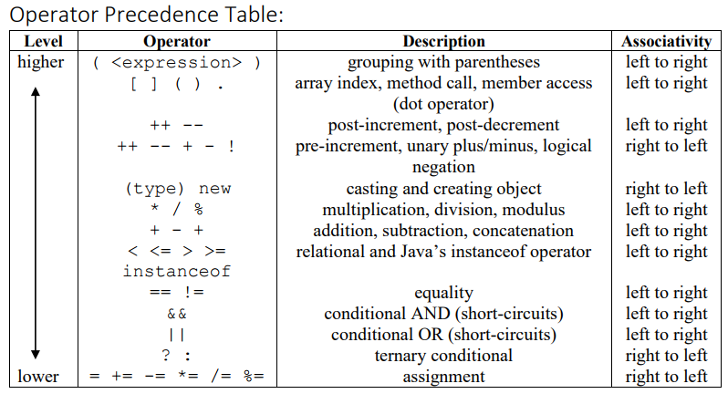
Operators

Slide 19
Evaluating Java Expressions
Precedence
Associativity
Sub-expressions left-to-right

Slide 20
Key Principles
Algorithms
Abstraction

Slide 21
Control Flow
Sequence
Methods
Conditionals
Loops

Slide 22
Data Structures
Arrays: single and multi-dimensional
ArrayLists
ArrayLists of Arrays

Slide 23
Development Process
Edit-Compile-Run cycle
Analysis - understand the problem
Design - pseudocode

Slide 24
Best Practices
Incremental, systematic, frequent deliverables
Test frequently
Test bench with testing methods

Slide 25
Debugging Techniques
Stepping through in Java Visualizer
print statements to verify and narrow down problem
print statements with DEBUG flag
Eclipse debugger

Slide 26
Programming Paradigms
Structured Programming
Object-Oriented Programming (brief)

Slide 27
Study Tips
Labs are essentially weekly Study Guides
Trace and Explain are intended to teach specific concepts and challenging aspects.
Preparing to teach is a very effective way to learn.
Imagine you are preparing yourself to teach this material to others this summer or soon.
Go through the labs, explaining to someone (maybe imaginary) what each trace and explain segment is doing.

Slide 28
Exam Tips
Come early, many to scan in.
Assume there is a bug in each code segment
You have to be able to determine what it is and explain exactly how it currently works in order to fix it.

Slide 29
Memory areas
static: holds static variables when class is loaded into memory.
heap: where instances/objects are allocated
stack: where local variables and parameters are allocated each time a method is called.

Slide 30
Exceptions
new Exception() //records the stack trace
throw //starts live exception handling
throws //method may throw an exception
try-catch //stops live exception handling
finally //code to always execute

Slide 31
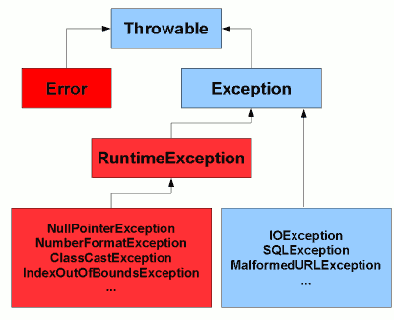
Exception Handling
3 Categories
Error - internal system errors
Unchecked Exceptions
RuntimeException
Checked Exceptions
Exception
http://www.javamex.com/tutorials/exceptions/exceptions_hierarchy.shtml

Slide 32
Programming Process & Errors
Naming/Saving
Syntax/Compile time
Runtime & Logic
Users
Editor
Compiler
(Virtual)
Machine
Hello.java
Hello.class
Computer
Files
Programmer

Slide 33
Classes
Class vs Instance Members (from docs)
Creating your own

Slide 34
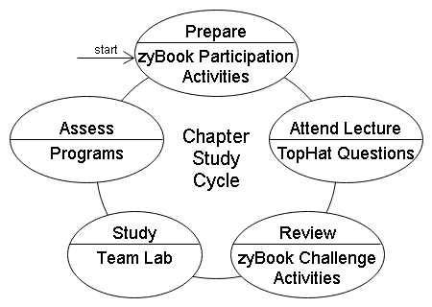
CS 300 Suggestion
Setup your own weekly study group reviewing & discussing previous weeks material.

Slide 35
Good Luck on Exam!
Have a Great Summer!

Slide 36
Which is false?
every instance will have the exact same toppings
toppings is a class variable
can be accessed by any method
cannot be changed
class Pizza {
static String toppings;
}
Notes:
A, B & C are true
D is false since toppings would have to be 'final' to not be changed.

Slide 37
toppings is a(n)
class Pizza {
private String toppings;
public String getToppings() {
if ( toppings == null)
toppings = "no toppings";
return toppings;
}
}
instance (non-static) variable
class (static) variable
parameter
local variable
Notes:
A is true,
B, C and D are false

Slide 38
getToppings() is a(n)
class Pizza {
private String toppings;
public String getToppings() {
if ( toppings == null)
toppings = "no toppings";
return toppings;
}
}
method
getter
accessor
provides read-only access to toppings field
All of the above
Notes:
All are true.

Slide 39
The visibility modifier private is
appropriate
should be public
doesn't allow a user of this class to change the field (attribute) directly
allows only methods within this class to change the field.
class Pizza {
private String toppings;
public String getToppings() {
if ( toppings == null)
toppings = "no toppings";
return toppings;
}
}
Notes:
A, C & D are true
B is false

Slide 40
Which is false?
class Pizza {
private String toppings;
public void setToppings( String tops) {
if ( tops != null && tops.length() > 0)
toppings = tops;
}
}
is a class method
can change toppings (write access)
is a setter
is a mutator
Notes:
B, C and D are all true.
A is false as setToppings does not have the 'static' keyword in the header before void.

Slide 41
Does this print true or false?
class Person {
private boolean something = false;
boolean getThing(boolean something) {
return this.something;
}
public static void main(String []args) {
Person p = new Person();
System.out.println( p.getThing( true));
}
}
true
false
error/other
Notes:
try it and see.

Slide 42
Which is true?
error - no constructor
Object classes' toString() will be called
an instance of Light has nothing in it
error
class Light {
}
// in some method
Light aLight = new Light();
System.out.println( aLight);
Notes:
A: false, since there is no constructor the default, no-arg constructor is provided by the compiler
best answer: B: Object classes' toString() will be called
C: false, since Light implicitly extends from Object and therefore when instantiated has all the instance fields of class Object within it.
D: no error noted, although code isn't complete as shown, but with reasonable assumptions should run.

Slide 43
What will print out?
0
1
can't access a private field outside the class
error
class Employee {
private static int employeeCount = 0;
private final int id;
Employee() {
this.id = ++employeeCount;
}
public static void main(String []args) {
Employee anEmployee = new Employee();
System.out.println( anEmployee.id);
}
}
Notes:
try it and see

Slide 44
Does this print 0, 1, other or error?
public class Person {
static int count = 0;
private int id;
Person() {
this.id = ++count;
}
public static void main(String []args) {
System.out.println( Person.count);
}
}
0
1
other
error
Notes:
try it and see

Slide 45
What will print out?
0
1
can't access a private field outside the class
error
class Employee {
private static int employeeCount = 0;
private final int id;
Employee() {
this.id = employeeCount++;
}
public static void main(String []args) {
Employee anEmployee = new Employee();
System.out.println( anEmployee.id);
}
}
Notes:
try it and see

Slide 46
Bike
Design a bike class.
Instance Fields: numWheels, Color, unique id
Class Field: numBikesCreated, used to assign unique id’s to each bike.
Constructor: numWheels and Color, automatically sets the unique identifier.
Instance Methods: Number of Wheels and id can be accessed but not changed. Color can be changed. Add a toString() method to return all instance field values in String form.
Class Method: returns the number of bikes created.
Draw the UML diagram and then write the code.
Create a BikeShop class that creates 10 bikes and stores in an array.
Print out each bike’s number of wheels, color and id using the toString method.
Notes:
Can you write the code and draw the diagram?

